Slide 1
Gas concentration prediction based on the response of MOF sensor array
Gbenga Fabusola

Slide 2
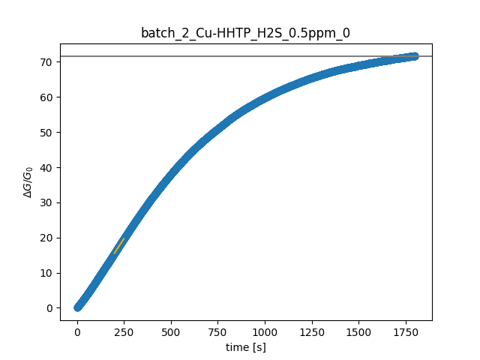
Data Extraction
Three features are extracted from the sensor response,
Initial slope
Saturation
Area under the response curve

Slide 3
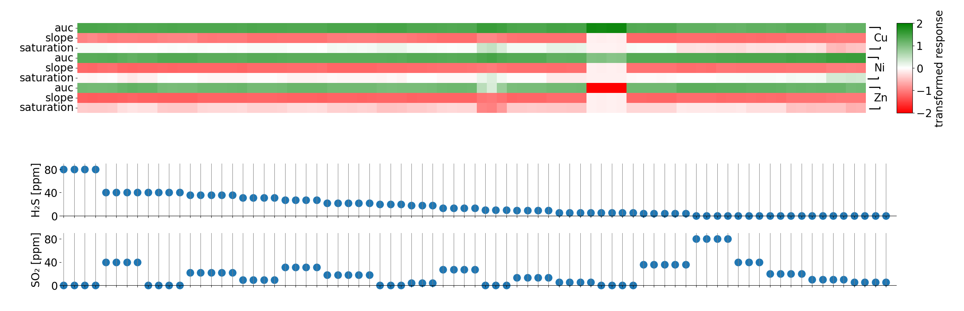
Feature matrix

Slide 4
methods and result
 |  | X-RF |  | RF |  | XGBoost
MOFs | Features | H2S | SO2 | H2S | SO2 | H2S | SO2
Cu, Zn | Saturation, slope | .35 | .43 | .36 | .53 | .41 | .4
 | Slope, auc | .31 | .46 | .3 | .55 | .09 | .27
 | All | .29 | .43 | .31 | .54 | .14 | .34
All mof (only batch Ni-2) | Saturation, slope | .36 | .63 | .2 | .58 | .71 | .14
All mof (only batch Ni-2) Saturation-10mins | Saturation, slope | .4 | .45 | .13 | .39 | .25 | .06
Cu, Zn | Saturation, slope | .35 | .43 | .36 | .53 | .41 | .4
Auc( 10 mins) | Saturation, slope | .31 | .44 | .41 | .55 | .23 | .36
All(Ni-2) | All | .41 | .26 | .19 | .39 | .68 | .26

Slide 5
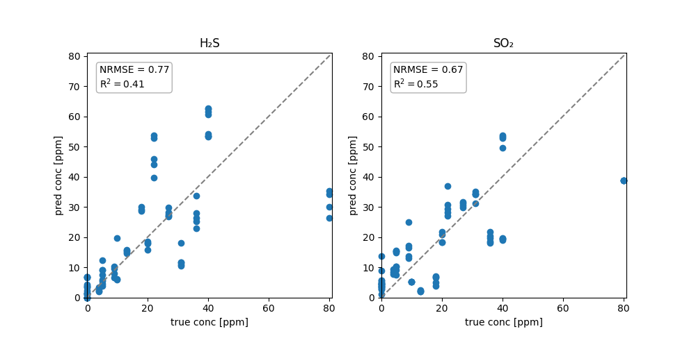
Model evaluation

